Slide 1
Northern Ireland.

Slide 2
map

Slide 3
Flag of Northern Ireland.

Slide 4
Symbol.

Slide 5
Population:2 million Capital City: Belfast Symbol: shamrock, clover.

Slide 7
Northern Ireland.
Northern Ireland, United Kingdom of Great Britain and Northern Ireland, situated in the north-eastern part of the island of Ireland. The capital and largest city - Belfast.

Slide 8
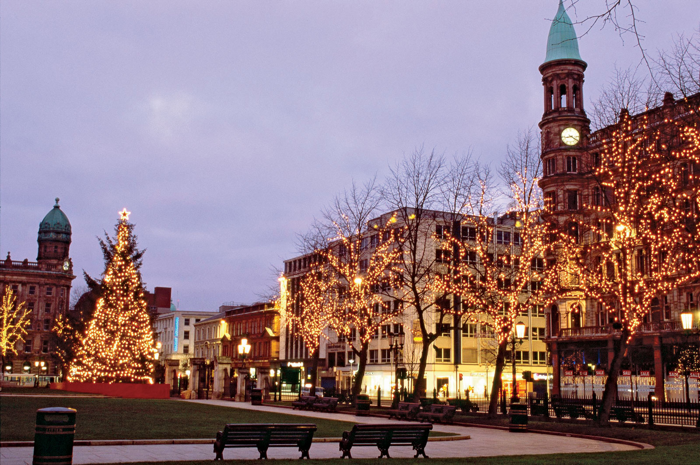
Ireland - this is one of the most popular tourist countries in Europe.

Slide 9
The capital of Northern Ireland - Belfast.

Slide 10
The city is actively boiling, and cultural life, are numerous exhibitions and fairs. Belfast is considered to be the center of cultural and political life of Northern Ireland.

Slide 11
Capital - Belfast
Belfast can be considered normal busy city like any other capital of the world, it is crowded and bustling.

Slide 12
Belfast is rich and historical events. For example, it is at its shipyards built the "Titanic." Generally, the capital of Northern Ireland has long been considered a major industrial center.

Slide 13
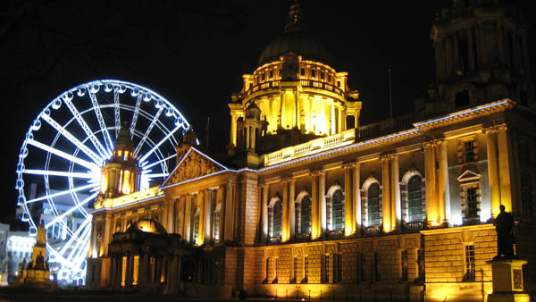

Slide 14
Attractions in Belfast are many and varied. The most significant of which Castle in Belfast, located on the slope of Cave Hill, there is a park, "Cave Hill".

Slide 15
Old Town.

Slide 17
An ancient castle in Northern Ireland, Antrim.

Slide 18
The former castle of kings of Ireland on the Atlantic coast.

Slide 19
Nature of Ireland.

Slide 25
END.
Fulfilled:
Obukhova Valeria.

